Slide 1

4 The People
Zainab Sirajo, Tomaney Hendricks, Nailah Berube, Nick Bourne, Ayoub Osman

Slide 2
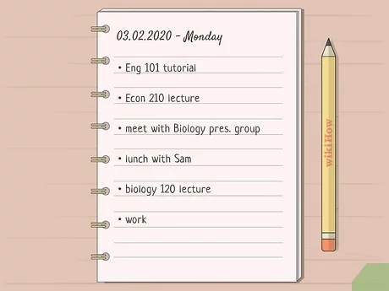
Project Selection: To-Do List
A to-do list or task monitor system can be used by a variety of users.
The system can be used for personal or team productivity to help with time management.

Slide 3
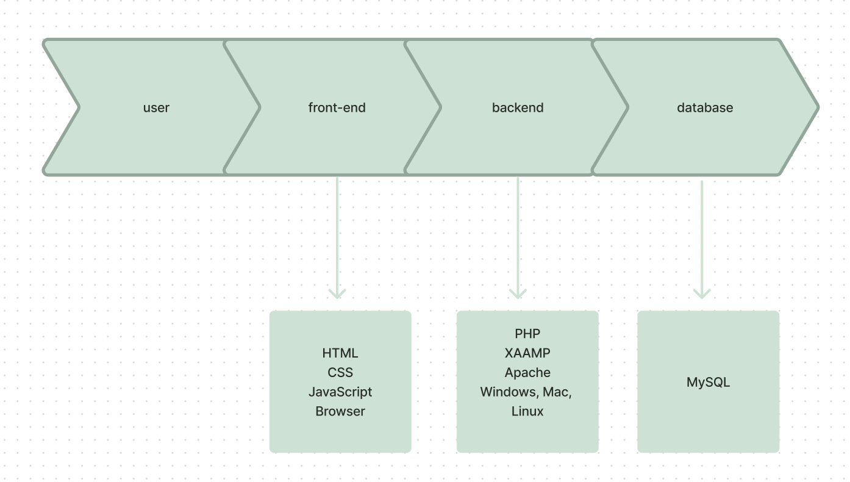
System Design

Slide 4
User Stories
Prioritization
Task Progression
Collaboration
Reminder/Calendar

Slide 5
Functional Requirements
Task Creation
Edit & Delete Tasks
Task Progression
Collaboration
Search Functionality
Due Dates and Reminders
Login
Graphics
Export
Task Organization

Slide 6
Non-Functional Requirements
Accessibility
User Interface Design
Integration with Other Tools
Time Zone
Storage
Recovery Time
Code Maintainability
Load Test
Fault Tolerance
Authorization

Slide 7
Main Use Cases
Task Creation (code demo)
Task Organization/Prioritization (code demo)

Slide 8
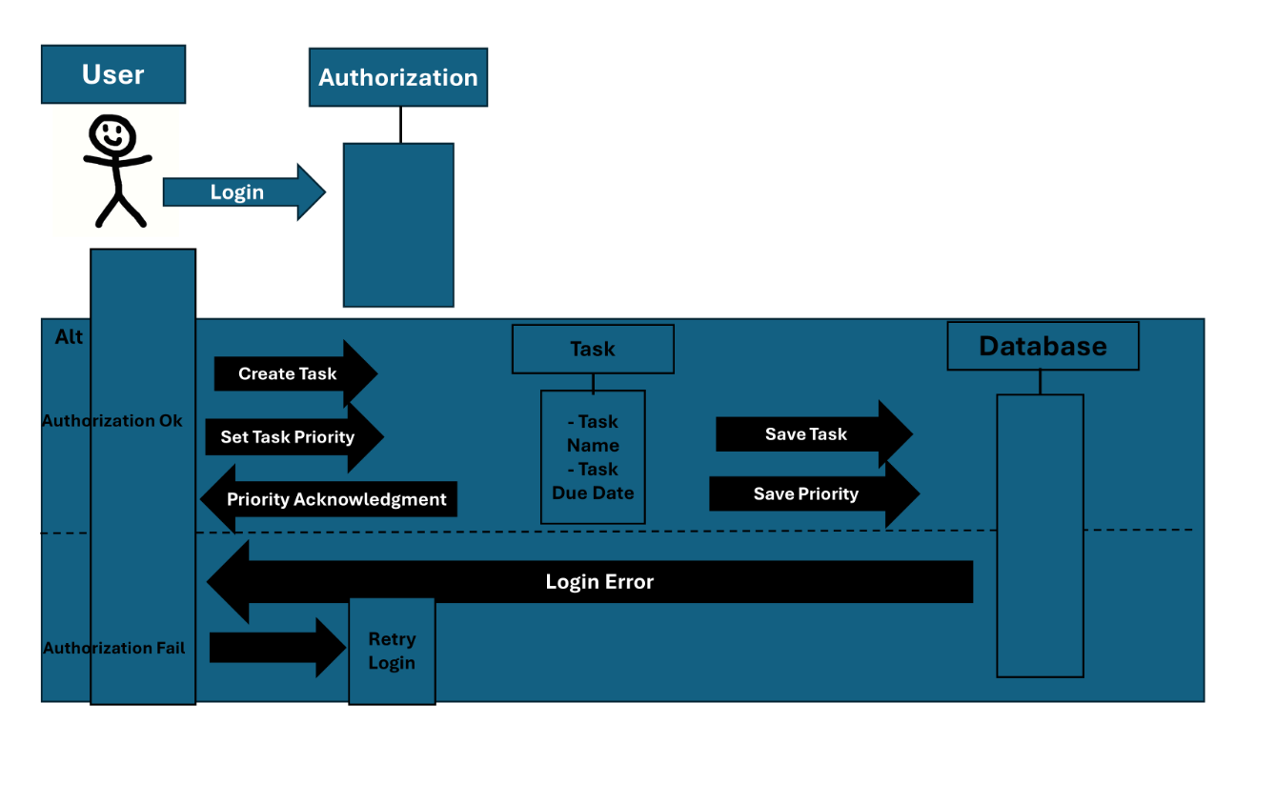
Sequence Diagram

Slide 9
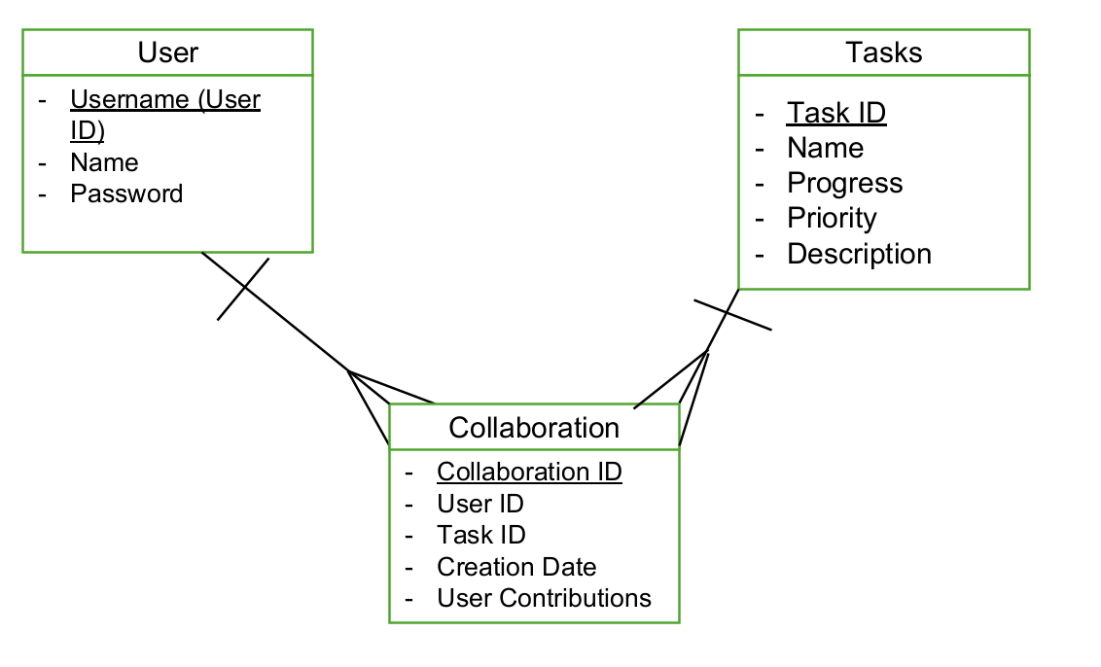
ERD

Slide 10
Sign up/Login Page (add code demo)
Sign Up Form: Fields for Email and Password
Sign Up Button
Sign - In Form: Fields for Email and Password
Sign In Button

Slide 11
Dashboard (add code demo)
Task Overview: Today's Tasks, Overdue Tasks, Upcoming Tasks, Completed Tasks
Task Management: Add New Task Button, List of Task with Checkbox, Task Name, Due Date, Priority
Task Details: Task Name, Due Date, Priority Level, Notes, Edit and Delete Options
Reminders: Set Reminders for Tasks
Collaboration: Share Tasks/Projects with other users
Log Out

Slide 12
Project Goal
Summary of the team's experience with the project’s purpose/ goal, and how much was achieved.
Goal: Develop a user-friendly and efficient web application that helps users manage their tasks effectively through a to-do list interface.
Deliverables: Task management, Intuitive Interface, Collaboration Features, Reminder System

